Slide 1

Peer Programming
By Oliver Williams and Patrick Johnson
Tutor: Clinton Hayes
GitHub Link: https://github.com/Happypat900/cybersectech-ass2.1-peerprogram

Slide 2
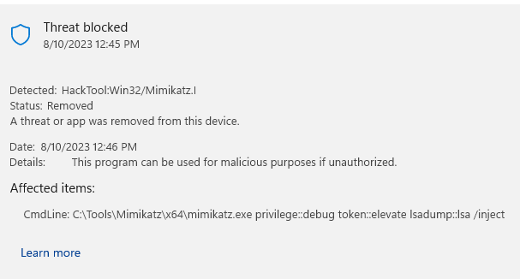
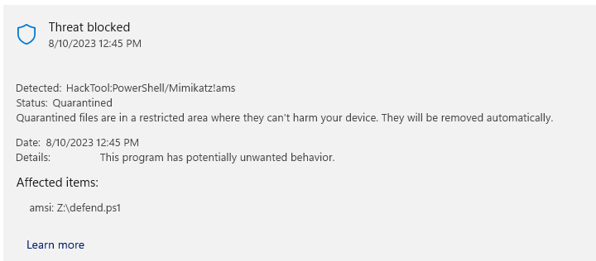
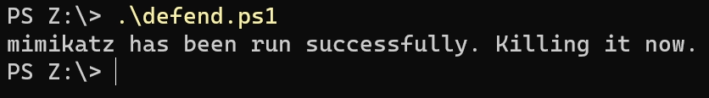
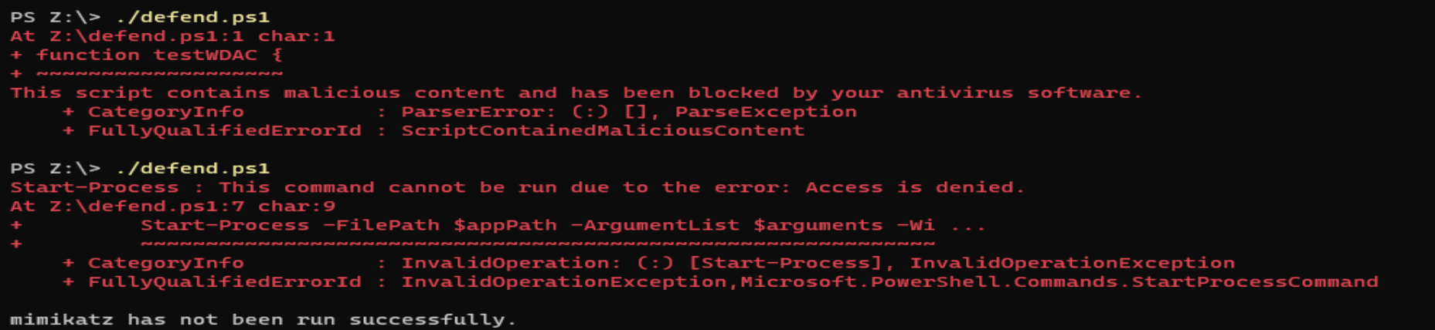
Pre-testing
2. Pre-test: write a function testWDAC() that: a. Attempts to run an “unauthorised” app such as keyfinder.exe and checcks whether the app has been run successfully, for example, using Get-Process.

Slide 3
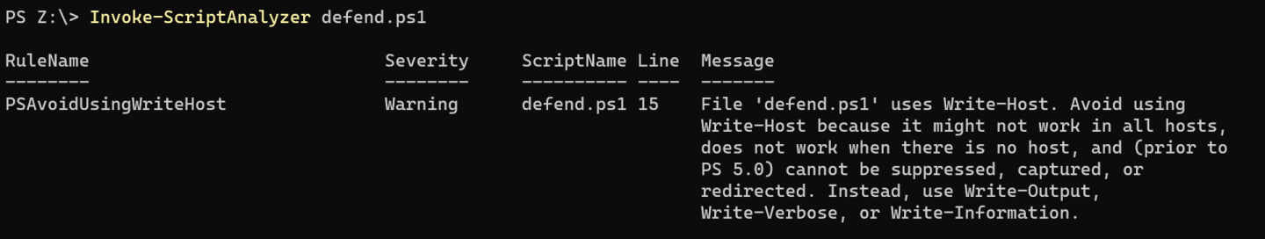
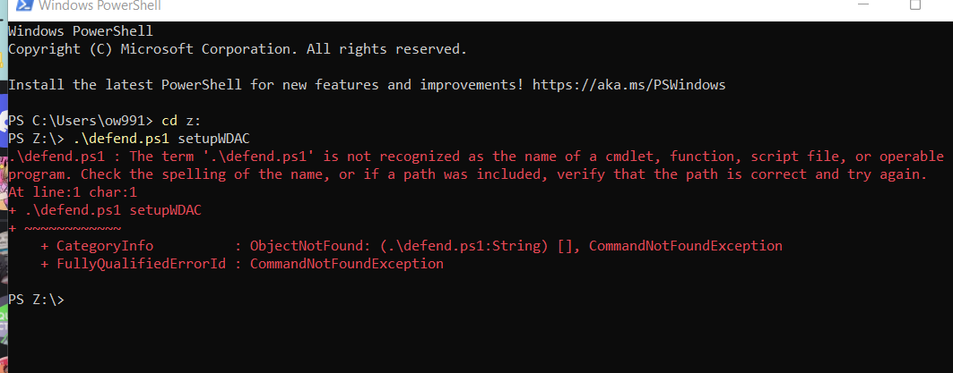
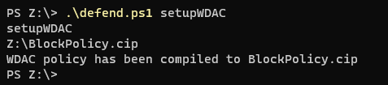
3. Document your code. Clean up your code using PSScriptAnalzyer
4. Write a function setupWDAC() that compiles a block WDAC policy to a .cip file using ConvertFrom-CIPolicy

Slide 4
References
How to correctly check if a process is running and stop it (2015) Stack Overflow. Available at: https://stackoverflow.com/questions/28481811/how-to-correctly-check-if-a-process-is-running-and-stop-it (Accessed: 15 August 2023).
Pamnani, V et al. (2023) Understand windows defender application control (WDAC) policy rules and file rules - windows security, Windows Security | Microsoft Learn. Available at: https://learn.microsoft.com/en-us/windows/security/application-security/application-control/windows-defender-application-control/design/select-types-of-rules-to-create (Accessed: 15 August 2023).

